Slide 1
Lunch time
Electronics Discussion
Meeting Goals:
  Exchange information on current activities and interests.
    related to Product Data Exchange
    focusing on Electronics, Systems Engineering, etc.
  Discuss involvement of JABIL Circuits
    with PDES, Inc. Electrical Mechanical Pilot
  Discuss possible formation, participants and specifics of an Avionics Pilot

Slide 2
Lunch time
Electronics Discussion
Agenda (rough):
  Introductions
    name, company, background:
  EM Pilot review
  Individual Company review:
    JABIL Circuits
    Boeing
    Rockwell
    NASA (Goddard)
    Georgia Tech
    LK Soft

Slide 3
Lunch time
Electronics Discussion
Company and personnel introduction
  Who is involved
    Level of effort, funding, etc.
  What is/are your interest areas
    Electronics, data exchange, data retention, etc
  What is Present involvement
    Developing translators, tools, standard, etc.

Slide 4
Lunch time
Electronics Discussion
Avionics Pilot
  Support the intelligent exchange of system requirements, electrical, mechanical and manufacturing information between companies.
  Participants:
    Boeing, Georgia Tech, IBM, JABIL Circuits, LKSoft, NASA (Goddard/JPL), Rockwell-Collins, and others TBD.
  Timeframe: May 2003 - TBD

Slide 5
Electromechanical Pilot
Greg Smith
May 8, 2003

Slide 6

EM Pilot
Accomplishments Since the Last TAC
Completed AP210 activities
  Working Draft 34
  ARM EXPRESS updated
  Mapping tables updated
  AIM EXPRESS structure updated
    AIM rules completion in process
  Built significant printed circuit design test cases (using company proprietary data)
  Translators and applications being updated
Notes:
Keenan, Michael T:
Plan on getting WD28 out Monday, WD26 available now. Concentration will then shift to AIM rules to complete changes. AP210 module work in support of AP233 was to be funded with NRO funding.
Tom Thurman:
change references to wd28 to wd30 on slide 4

Slide 7
EM Pilot
Accomplishments Since the Last TAC (cont.)
Continuing “second wave” of STEP AP210 translator development
  AP210 <-> Mentor/Zuken/Eagle:
    Beta translators available for Zuken and Mentor (Working Draft 34)
  IDF -> AP210:
    Very near completion (Working Draft 34)
Notes:
Keenan, Michael T:
Plan on getting WD28 out Monday, WD26 available now. Concentration will then shift to AIM rules to complete changes. AP210 module work in support of AP233 was to be funded with NRO funding.
Tom Thurman:
change wd26 to wd30 on slide 5

Slide 8




EM Pilot
Accomplishments Since the Last TAC (cont.)
AP210 maturity index
  Assembly well tested, stable
  Layout tested,
  Sources/sinks reduced
  Requires inter-enterprise
  pilot exchanges
    (e.g., library-library)
AP210
is
Rock Solid!

Slide 9
EM Pilot
Status of AP210 document
Introduction | Changes to be listed
1. Scope | ✓ Unchanged
2. Normative references | Update needed
3. Definitions and Abbreviations | ✓ Unchanged
4. Information requirements (ARM) | -
4.1 Units of functionality | ✓ Done
4.2 Application object | ✓ EXPRESS done Some textual definitions missing
4.3 Application assertion | ✓ Done
5. Application Interpreted Model (AIM) | -
5.1 Mapping table | ✓ Done
5.2 AIM EXPRESS short listing | ✓ Done, except rules
6. Conformance requirements | Update needed
Annex G, H: EXPRESS-G diagrams | Update needed
A new Annex: | ? EXPRESS AIM rules for ARM constraints
Documentation for AP210 - Minor Amendment
Notes:
As of today my comments are:
Clause42 - Needs significant work that Darla will be doing.
Clause51 - There are some outstanding mapping issues (3 I believe)
If this is the status after wd34 is out they will be done.

Slide 10

EM Pilot
Accomplishments Since the Last TAC (cont.)
Completed AP210 activities to support initial Rockwell-Collins production usage
  Resolved minor attribute issues
  Resolved product category issues
  Identified enterprise data source issues
    Component data
    Material data
    Design data
    PDM data
    Process data

Slide 11
EM Pilot
Accomplishments Since the Last TAC (cont.)
Initial requirements gathered for component modeling tool
  Native AP210 application
  Utilizes multiple, coupled views
  Performs validation of assembly structures (e.g., connector mating pair)
  Provides a front-end for a unified STEP enterprise component library
  Developed in cooperation with the University of Illinois Champaign Urbana

Slide 12
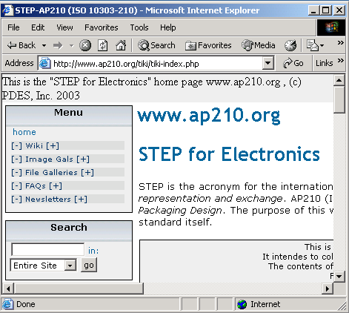
EM Pilot
Accomplishments Since the Last TAC (cont.)
2D Package
Extraction
Part Package
Requirements
Component
Modeling
Tool
2 1/2D Package
Extraction
(Length/Width + Height)
STEP AP203
Models
Support:
Definition of features and shapes
Definition of electrical and mechanical parameters
3D Package
Extraction
Notes:
Initial requirements gathered for component modeling tool
Native AP210 application
Utilizes multiple, coupled views
Performs validation of assembly structures (e.g., connector mating pair)
Provides a front-end for a unified STEP enterprise component library
Developed in cooperation with the University of Illinois Champaign Urbana

Slide 13
EM Pilot
Accomplishments Since the Last TAC (cont.)
Continuing AP210 publicity/advocacy
  International Workshop on Aerospace Product Data Exchange - Aerospace PDE 2003 (Apr 03)
    Product Data Exchange at Boeing
    STEP for Electronics
    Characterizing Fine-Grain Associativity Gaps: A Preliminary Study of CAD-CAE Model Interoperability
    The Pan Galactic Engineering Framework
    Enhancing Design-for-Manufacturability Using the ISO 10303 Standard for Electronics Design: AP210
Notes:
Keenan, Michael T:
The current plan is use AP210 for the functional part of schematics and AP214 for the drawing structure.

Slide 14
EM Pilot
Accomplishments Since the Last TAC (cont.)
Continuing AP210 publicity/advocacy
  NASA Goddard (Apr 03)
    STEP for Electronics
    Characterizing Fine-Grain Associativity Gaps: A Preliminary Study of CAD-CAE Model Interoperability
    The Pan Galactic Engineering Framework
    Enhancing Design-for-Manufacturability Using the ISO 10303 Standard for Electronics Design: AP210
Notes:
Keenan, Michael T:
The current plan is use AP210 for the functional part of schematics and AP214 for the drawing structure.

Slide 15
EM Pilot
Accomplishments Since the Last TAC (cont.)
Standards Comparison
Electrical
Functionality
Mechanical
Functionality
Functionality
GERBER,
HP-GL,
DXF
IPC-
D350
ODB++
GenCAM
EDIF
STEP
AP210
IDF
IGES
DXF
AP203
Evolution
Evolution

Slide 16
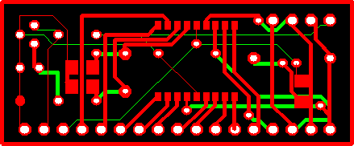

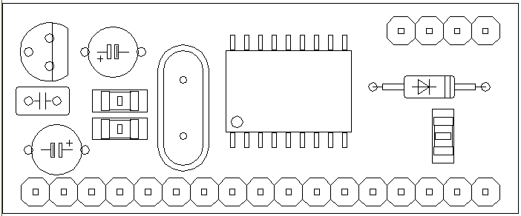
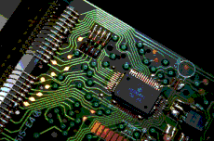




Integration Status Electro-Mechanical Pilot
Electronics Domain - Spring 2002
Most Recent Version: AP210 IS WD18
GERBER, Excellon,
Barco-DPF, HP-GL,
DXF, ODB++, IPC-D370D
EDIF/VHDL
IDF
AP203
Structure
/ Nodal
Electro-Mech
IDF to AP210
Converter
STEP
AP203 to AP210
Converter
Manufacturing
Gerber to AP210
Converter
CircuitCAM
Manufacturing
(IS WD3)
(IS WD11)
(IS WD8)
(IS WD8)
AP210
Eagle
(PWA DIS)
(BOM DIS)
(PWA IS WD3)

Slide 17
Integration Status Electro-Mechanical Pilot
Electronics Domain - Fall 2002
Most Recent Version: AP210 IS WD20
GERBER, Excellon,
Barco-DPF, HP-GL,
DXF, ODB++, IPC-D370D
EDIF/VHDL
IDF
AP203
Structure
/ Nodal
Electro-Mech
IDF to AP210
Converter
STEP
AP203 to AP210
Converter
Manufacturing
Gerber to AP210
Converter
CircuitCAM
Manufacturing
(IS WD3)
(IS WD12)
(IS WD12)
(IS WD8)
AP210
changes
Eagle
(IS WD18)
(IS WD18)
(PWA IS WD18)

Slide 18
Integration Status Electro-Mechanical Pilot
Electronics Domain - Spring 2003
Most Recent Version: AP210 IS WD34
GERBER, Excellon,
Barco-DPF, HP-GL,
DXF, ODB++, IPC-D370D
EDIF/VHDL
IDF
AP203
Structure
/ Nodal
Electro-Mech
IDF to AP210
Converter
STEP
AP203 to AP210
Converter
Manufacturing
Gerber to AP210
Converter
CircuitCAM
Manufacturing
(IS WD34)
(IS WD12)
(IS WD34)
(IS WD34)
AP210
changes
Eagle
(IS WD34)
(IS WD34)
(PWA IS WD34)
Notes:
Craig Lanning
The IDF -> AP210 direction is close to completion, but no work has been done on the AP210 -> IDF direction.
IDF -> AP210 is currently at WD32 and will move rather quickly to WD34 as soon as it is out.
Keenan, Michael T:
Updated versions, I’ll let you update the colors. I suggest red on AP203 to AP210 converter, since it isn’t being worked to my knowledge. I suspect that Eagle is beyond WD18 but I don’t know where.
Lothar/Geidrius:
AP210-Mentor New features - updated to WD34, created padstack occurrence, footprint occurrence (if library key is used).
Tested with all designs we have. Updated documentation, improved the style of it, reduced the amount of log file.
CADIF Visula and Mentor Boardstation to/from AP210 as Release candidate 1 version.
It is updated to most recent WD34.
Other converters - EDIF, VHDL, Eagle and CircuitCAM are updated to WD34 as well.
The same applies to STEP-Book AP210.
So everything is again in sync and up-to-date.
Tony is waiting for information from Tom

Slide 19



Integration Status Electro-Mechanical Pilot
Major Electronics CAD Applications
Future areas for Translation focus:
- - - - - - - - - PCB Desktop Tools - - - - - - - - -
Eagle
AP210
CR-5000
Expedition
Visula
CADIF
Allegro
Board
Station
Notes:
Honeywell - Board Station, Expedition, No Cadence, CR5000
Boeing - Board Station, Expedition
RCI - Visula, PADS
NASA Goddard - Mentor, ORCAD
NASA JPL - Mentor, others
LKsoft -

Slide 20
EM Pilot
Plans for the Next 6 Months including Carryover Tasks*
Commercialize and market AP210
  Support and fund development of Mentor and Zuken translators
    Provide technical expertise to ensure success
  Work with other Electromechanical consortium to drive AP210 use into other companies
    CAM-I Scalable Flexible Manufacturing Project
  Work with AP233 (systems engineering) to maximize AP210 re-use
  Introduce to additional university researchers

Slide 21
EM Pilot
Plans for the Next 6 Months including Carryover Tasks* (cont)
Move AP210 into production use
  Final implementation of Phase 1 environment at Rockwell-Collins
  Begin full production usage of DFX (Design For X) analysis process at Rockwell-Collins (rule set #1) in spring of 2003

Slide 22
EM Pilot
Plans for the Next 6 Months including Carryover Tasks* (cont)
AP210 publication (Minor Amendment)
  Update AIM EXPRESS rules
  Update documentation
Ensure continued participation
  Develop and submit relevant proposals to appropriate agencies to obtain funding
  Utilize funding to extend and implement AP210 where feasible
    AP210 module work in support of AP233
  Extensions (e.g., schematics) based on funding

Slide 23
EM Pilot
Plans for the Next 6 Months including Carryover Tasks* (cont)
AP210 Training (future)
  Honeywell in June
  Germany in October
AP210 Avionics Pilot (future)
  Goal: support the intelligent exchange of system requirements, electrical, mechanical and manufacturing information between companies
  Participants:
    Boeing, Georgia Tech, IBM, JABIL Circuits, LKSoft, NASA (Goddard/JPL), Rockwell-Collins, and others TBD.
  Timeframe: May 2003 - TBD

Slide 24
EM Pilot
Challenges
Team participation
  Tie AP210 into company production activities
  Submit proposals and obtain funds to support AP210 company implementation
  Documentation and rules development problem!!!
  Recommended Practices and Concept of Operations document out of date
Translator development/commercialization
  Support Mentor and Zuken marketing plans
  Continue to work with other companies from related consortium and pool funding
Notes:
The LKSoft rule generation software will mitigate some of the problems with rule development.

Slide 25
EM Pilot
Challenges (cont.)
Extending national utilization
  Work with, present to, and train individuals/companies from EM related consortium
    EM R&D Collaboration, CAM-I, EMPF, DSC
Extending international utilization
  Presentations at future European CAM-I meetings and International STEP for Aerospace Workshop

Slide 26
Electromechanical Pilot
Backup Slides

Slide 27
EM Pilot
Objective
The objective of the pilot is to:
Implement STEP for integrated electronic exchange of information between electrical designers, mechanical designers, and design analysis in the design of printed circuit assemblies and their mounting hardware and enclosures
Support the development and deployment of applications protocols within the EM Pilot domain

Slide 28
EM Pilot
Participants
Mike Keenan / Greg Smith – Boeing
  Support from Jim Adams, Jim Evans - Boeing
Mike Benda / Tom Thurman – Rockwell
  Support from University of Illinois
  Support from Teresa Wu from Arizona State
Steve Waterbury – NASA Goddard
  Support from Jim U’Ren - NASA JPL
Russell Peak / Miyako Wilson – Georgia Tech
  Support from Injoong Kim, Manas Bajaj - Georgia Tech
Lothar Klein / Giedrius Liutkus – LK Soft
Craig Lanning – Northrop Grumman IT (NASA)
Darla Nettles – ATI
Jim Kachmarshy – Tobyhanna Army Depot (US Army)
Ken Buchanan – ICF (US Army)
  plus a cast of many other characters!

